Slide 1
All-Pair shortest path
Floyd Warshall Algorithm

Slide 2
Shortest Path
Single-source shortest path algorithms
Bellman-Ford algorithm
Dijkstra algorithm
All-Pair shortest path algorithms
Floyd-Warshall algorithm

Slide 3
Floyd Warshall Algorithm
It is used to solve All Pairs Shortest Path Problem.
It computes the shortest path between every pair of vertices of the given graph.
Floyd Warshall Algorithm is an example of dynamic programming approach.

Slide 4
Floyd Warshall Algorithm
Just like Dijkstra’s algorithm, the Floyd Warshall algorithm is used to find the shortest path between all vertices in the weighted graph.
This algorithm works with both directed and undirected graphs but it does not work along with the graph with negative cycles.
Therefore, if the distance from the vertex v from itself is negative then we can assume that the graph has the presence of a negative cycle.
This algorithm follows the dynamic programming approach as its working pattern.
Here the algorithm doesn’t construct the path itself but it can reconstruct the path with a simple modification.

Slide 5
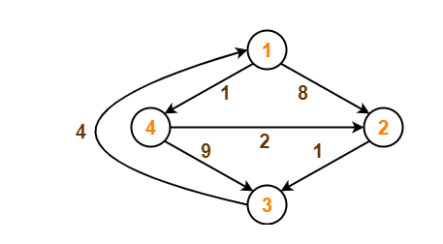
Floyd Warshall Algorithm
Consider the following directed weighted graph-
Using Floyd Warshall Algorithm, find the shortest path distance between every pair of vertices.

Slide 6
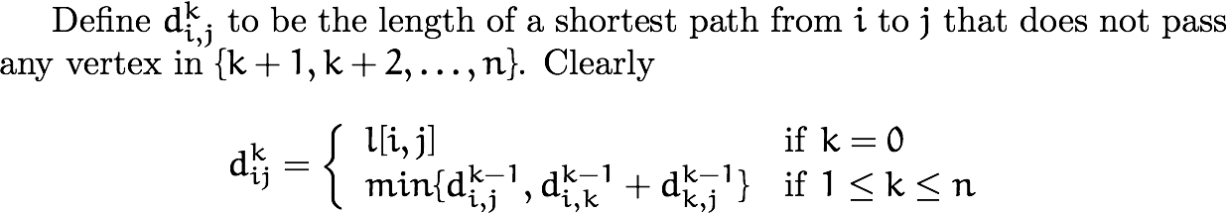
All-pairs shortest path

Slide 7
Floyd Warshall Algorithm
Step-01:
Write the initial distance matrix.
It represents the distance between every pair of vertices in the form of given weights.
For diagonal elements (representing self-loops), distance value = 0.
For vertices having a direct edge between them, distance value = weight of that edge.
For vertices having no direct edge between them, distance value = ∞.
Initial distance matrix for the given graph is-

Slide 8
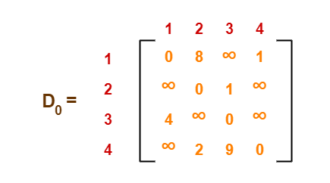
Step-01:
Write the initial distance matrix.
It represents the distance between every pair of vertices in the form of given weights.
For diagonal elements (representing self-loops), distance value = 0.
For vertices having a direct edge between them, distance value = weight of that edge.
For vertices having no direct edge between them, distance value = ∞.
Initial distance matrix for the given graph is-

Slide 9
Create a |V| x |V| matrix // It represents the distance between every pair of vertices as given
For each cell (i,j) in D do-
if i = = j
D[ i ][ j ] = 0 // For all diagonal elements, value = 0
if (i , j) is an edge in E
D[ i ][ j ] = weight(i,j) // If there exists a direct edge between the vertices, value = weight of edge
else
D[ i ][ j ] = infinity // If there is no direct edge between the vertices, value = ∞
for k from 1 to |V|
for i from 1 to |V|
for j from 1 to |V|
if D[ i ][ j ] > D[ i ][ k ] + D[ k ][ j ]
D[ i ][ j ] = D[ i ][ k ] + D[ k ][ j ]

Slide 10
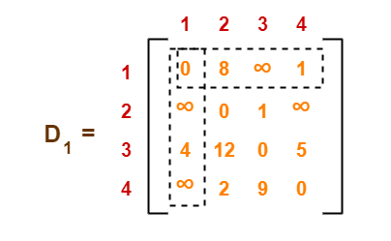
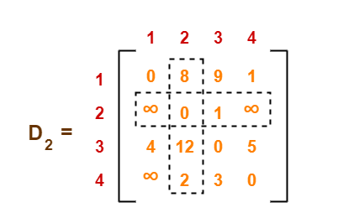
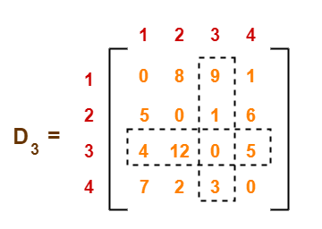
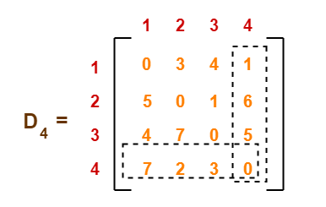

Slide 11
Remember
In the above problem, there are 4 vertices in the given graph.
So, there will be total 4 matrices of order 4 x 4 in the solution excluding the initial distance matrix.
Diagonal elements of each matrix will always be 0.
The last matrix D4 represents the shortest path distance between every pair of vertices.

Slide 12
Time Complexity-
Floyd Warshall Algorithm consists of three loops over all the nodes.
The inner most loop consists of only constant complexity operations.
Hence, the asymptotic complexity of Floyd Warshall algorithm is O(n3).
Here, n is the number of nodes in the given graph.

Slide 13
Application of Floyd Warshall Algorithm
Floyd Warshall Algorithm helps to find the inversion of real matrices
It helps in testing whether the undirected graph is bipartite
It helps to find the shortest path in a directed graph
Different versions of the Floyd Warshall algorithm help to find the transitive closure of a directed graph
This algorithm helps to find the regular expression the are accepted by finite automata.
It helps in finding the similarity between the graphs
Floyd Warshall algorithm helps in finding the optimal routing i.e the maximum flow between two vertices

Slide 14
Example
1
2
3
1
0
4
5
W = D⁰ =
1
2
2
0
∞
5
3
∞
-3
0
4
2
3
2
-3

Slide 15
k = 1 Vertex 1 can be intermediate node
1
1
2
3
5
D⁰ =
1
0
4
5
4
2
3
2
2
0
∞
2
-3
3
∞
-3
0
1
2
3
1
0
4
5
D¹ =
2
2
0
7
D¹[2,3] = min( D⁰[2,3], D⁰[2,1]+D⁰[1,3] )
= min (∝, 7)
= 7
D¹[3,2] = min( D⁰[3,2], D⁰[3,1]+D⁰[1,2] )
= min (-3,∝)
= -3
3
∞
-3
0

Slide 16
k = 2 Vertices 1, 2 can be intermediate
1
2
3
1
5
D¹ =
1
0
4
5
4
2
3
2
2
0
7
2
-3
3
∞
-3
0
1
2
3
1
0
4
5
D² =
D²[1,3] = min( D¹[1,3], D¹[1,2]+D¹[2,3] )
= min (5, 4+7)
= 5
D²[3,1] = min( D¹[3,1], D¹[3,2]+D¹[2,1] )
= min (∝, -3+2)
= -1
2
2
0
7
3
-1
-3
0

Slide 17
k = 3 Vertices 1, 2, 3 can be intermediate
1
1
2
3
5
D² =
1
0
4
5
3
4
2
2
2
0
7
2
-3
3
-1
-3
0
1
2
3
1
0
2
5
D³ =
2
2
0
7
D³[1,2] = min(D²[1,2], D²[1,3]+D²[3,2] )
= min (4, 5+(-3))
= 2
D³[2,1] = min(D²[2,1], D²[2,3]+D²[3,1] )
= min (2, 7+ (-1))
= 2
3
-1
-3
0

